Slide 1
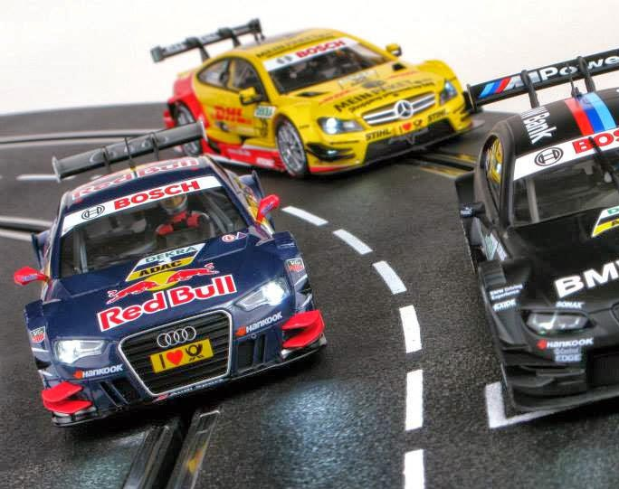
Using HTM to Perform Misbehavior Detection in Autonomous Vehicle Platoons
Ethan Swistak and Tushar Singhal

Slide 2
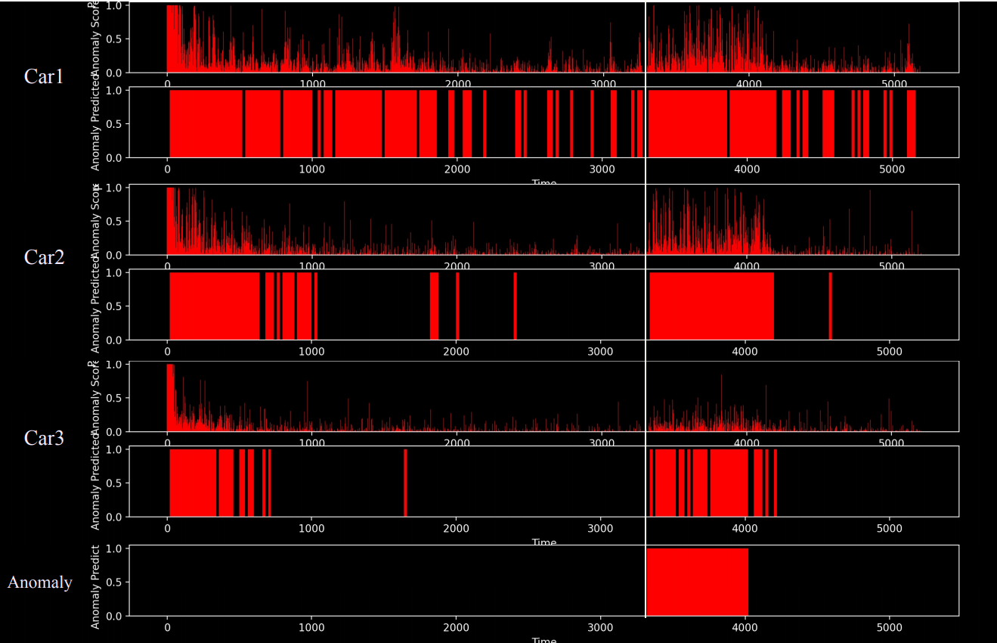
HTM Generalization Comparison

Slide 3
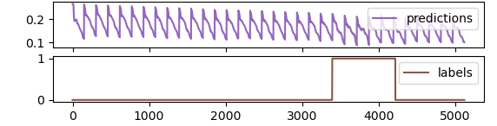
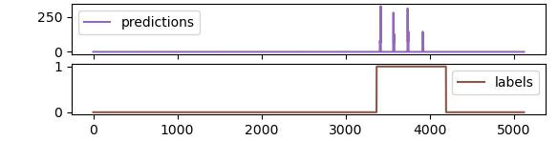
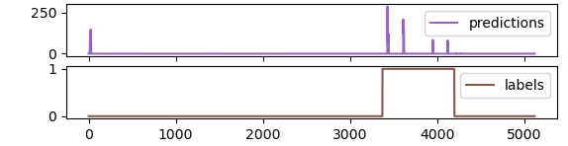
LSTM Autoencoder Generalization Comparison

Slide 4
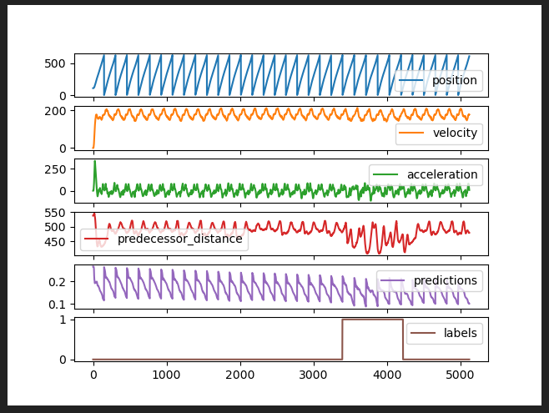
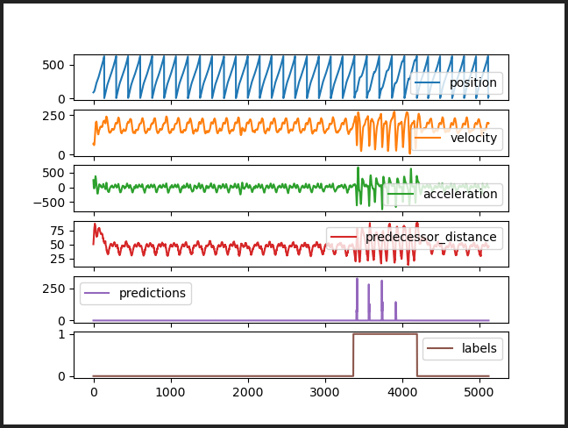
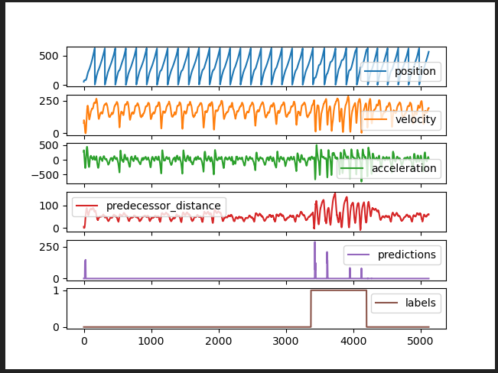
Detailed Comparison

Slide 5
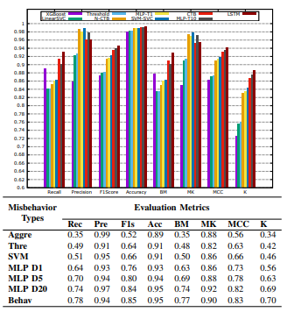

Slide 6
Challenges with reproducing results on veremi
Veremi has messages from 100’s of cars but the amount of data per car is limited to about 100 samples while it is in the “control zone”.
There is a variable number of cars in the control zone at any given time.
We can’t wait 30 seconds to begin doing anomaly detection, need to learn something from ground truth data or previous cars and apply it to new cars.
Don’t yet know exactly how to classify ground truth for the veremi dataset in terms of which messages are false.

Slide 7
Week 3 – Progress Summary
Completed This Week | To-Do
Generalization analysis across 3 cars Evaluated LSTM Autoencoder on across cars Removed windowing for comparison purposes | Gather more data, test HTM in real time? Figure out how to adapt to VeRemi? Use Veins to generate a new dataset?

